Slide 1
24GHz-Radar for Movement Detection
Group C3
Mahima desai 1127934
Sree Samanvitha Manoor Vadhoolas 1127974

Slide 2
Contents
Introduction
Block Diagram
KiCAD: Schematic
KiCAD: PCB
Soldered Board
State Machine
PSoC Configuration
State Machine Code
MATLAB Output
Test Setup for State Machine
Test Setup for 1st Stage
Test Setup for 2nd Stage
Test Setup with Radar
Gain and Corner Frequencies
CFAR
CFAR Results

Slide 3
Introduction
A 24 GHz radar sensor detects movements and sends detected signal to bandpass filter.
The 4th order Bandpass filter gives amplified signal as the output which in-turn is sent to the ADC.
PSOC calculates FFT of ADC data and sends it to MATLAB.
CFAR is used to set a threshold with which the probability of false alarm reduced.

Slide 4
Block Diagram
Radar module
4th order bandpass filter
ADC
Detection
CFAR
FFT

Slide 5
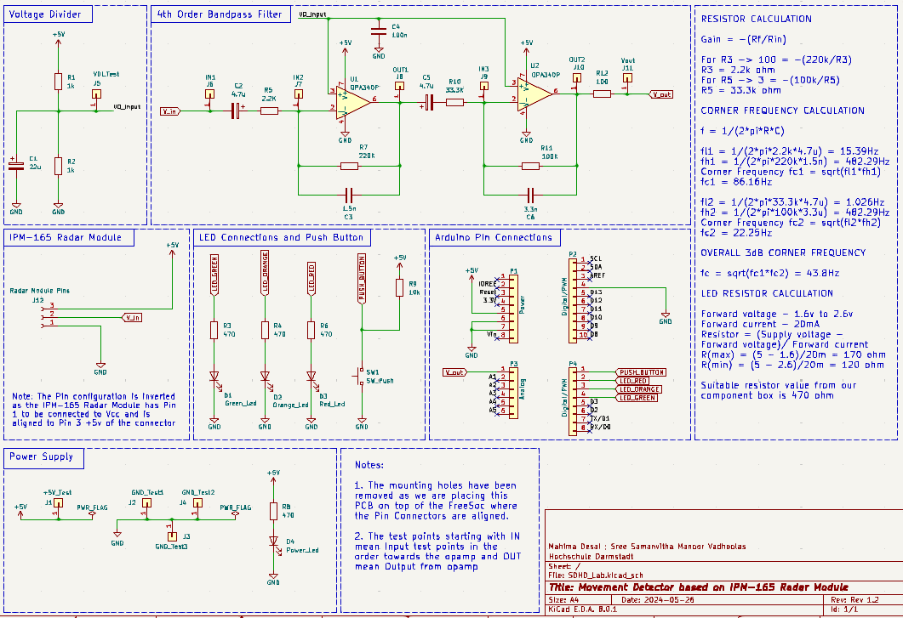
KiCAD: Schematic

Slide 6
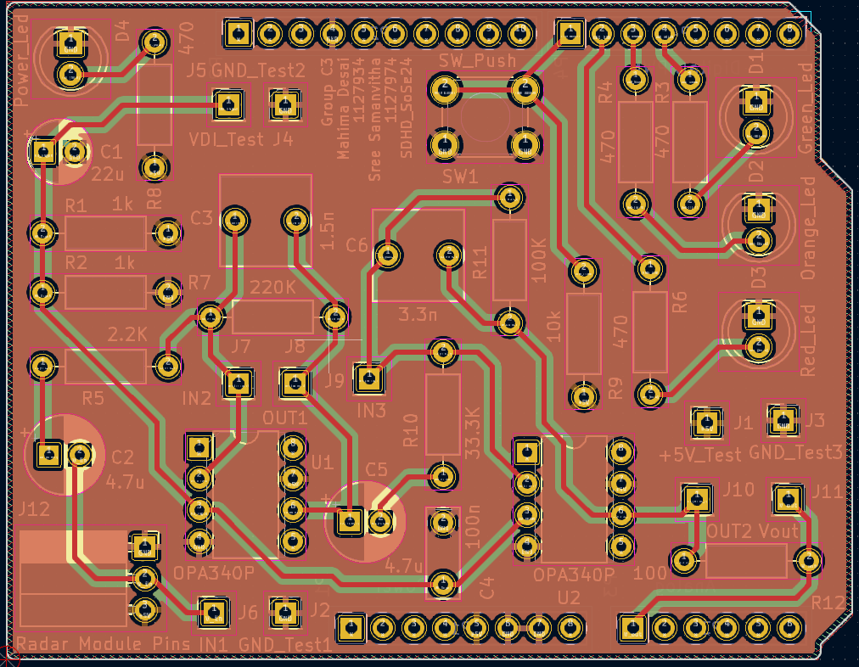
KiCAD: PCB

Slide 7
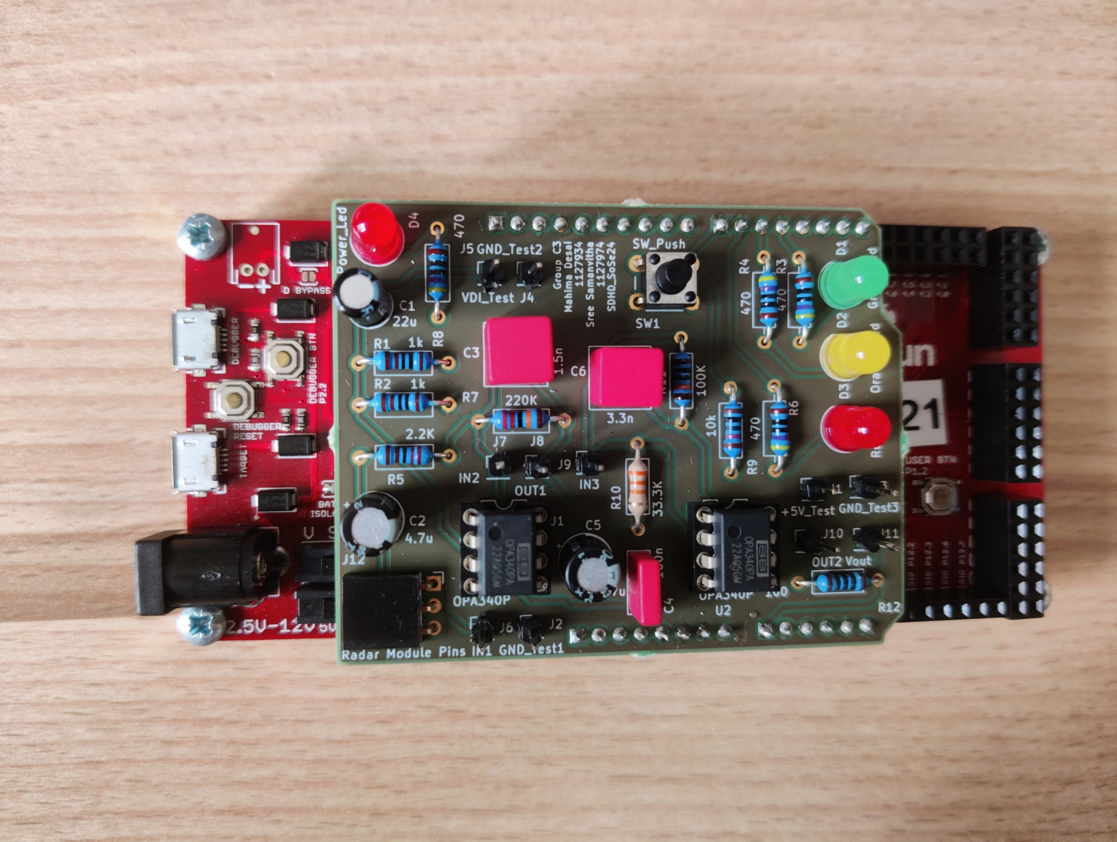
Soldered Board

Slide 8
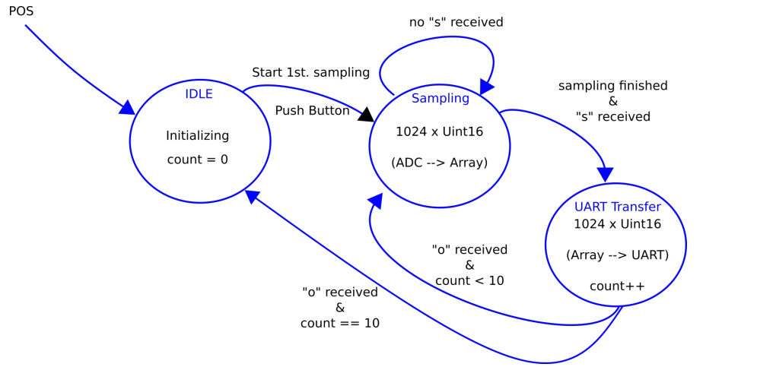
State Machine

Slide 9
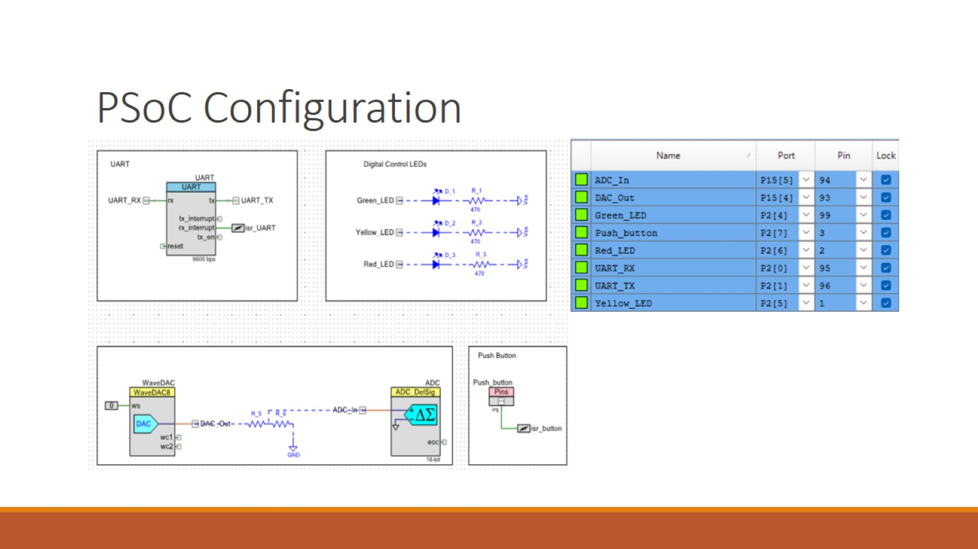
PSoC Configuration

Slide 10
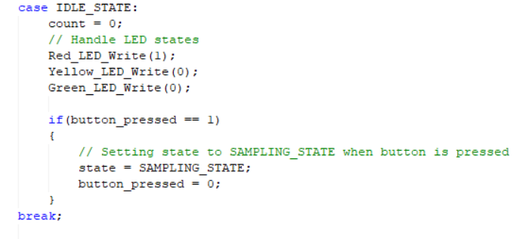
State Machine Code

Slide 11
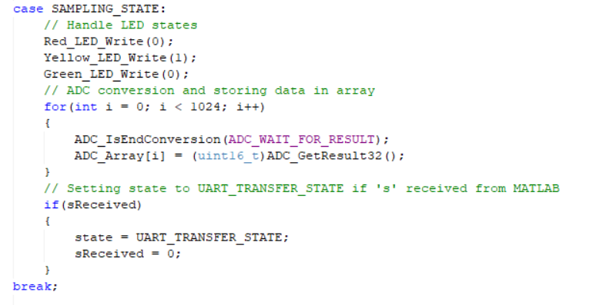
State Machine Code

Slide 12
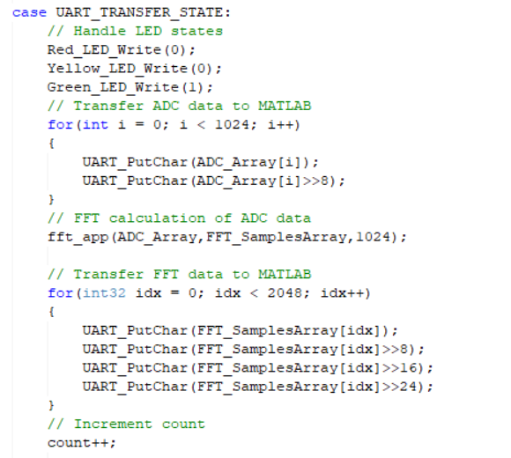
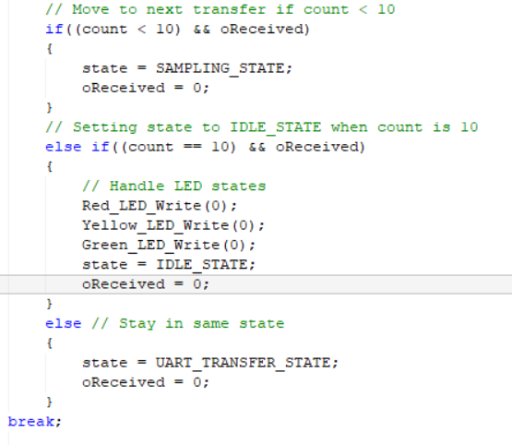
State Machine Code

Slide 13
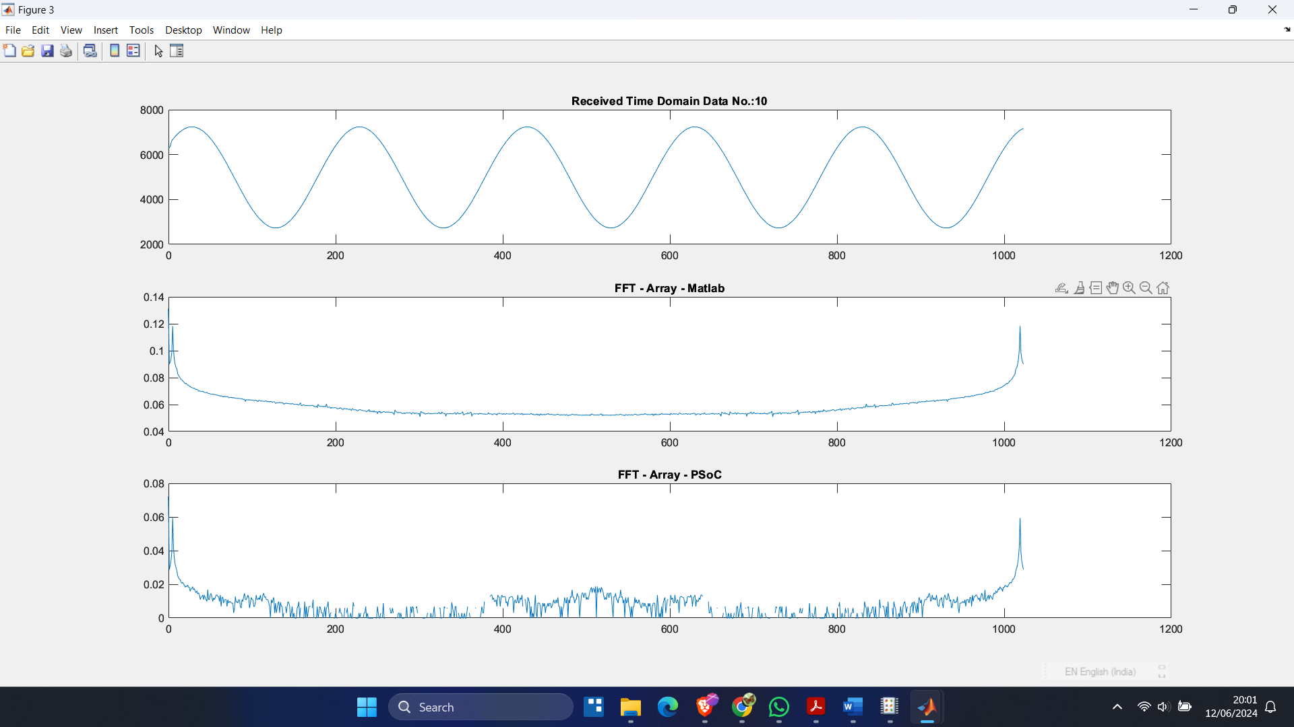
MATLAB Output

Slide 14
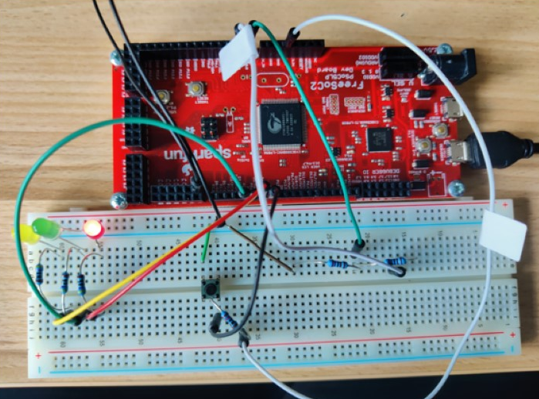
Test Setup for State Machine

Slide 15
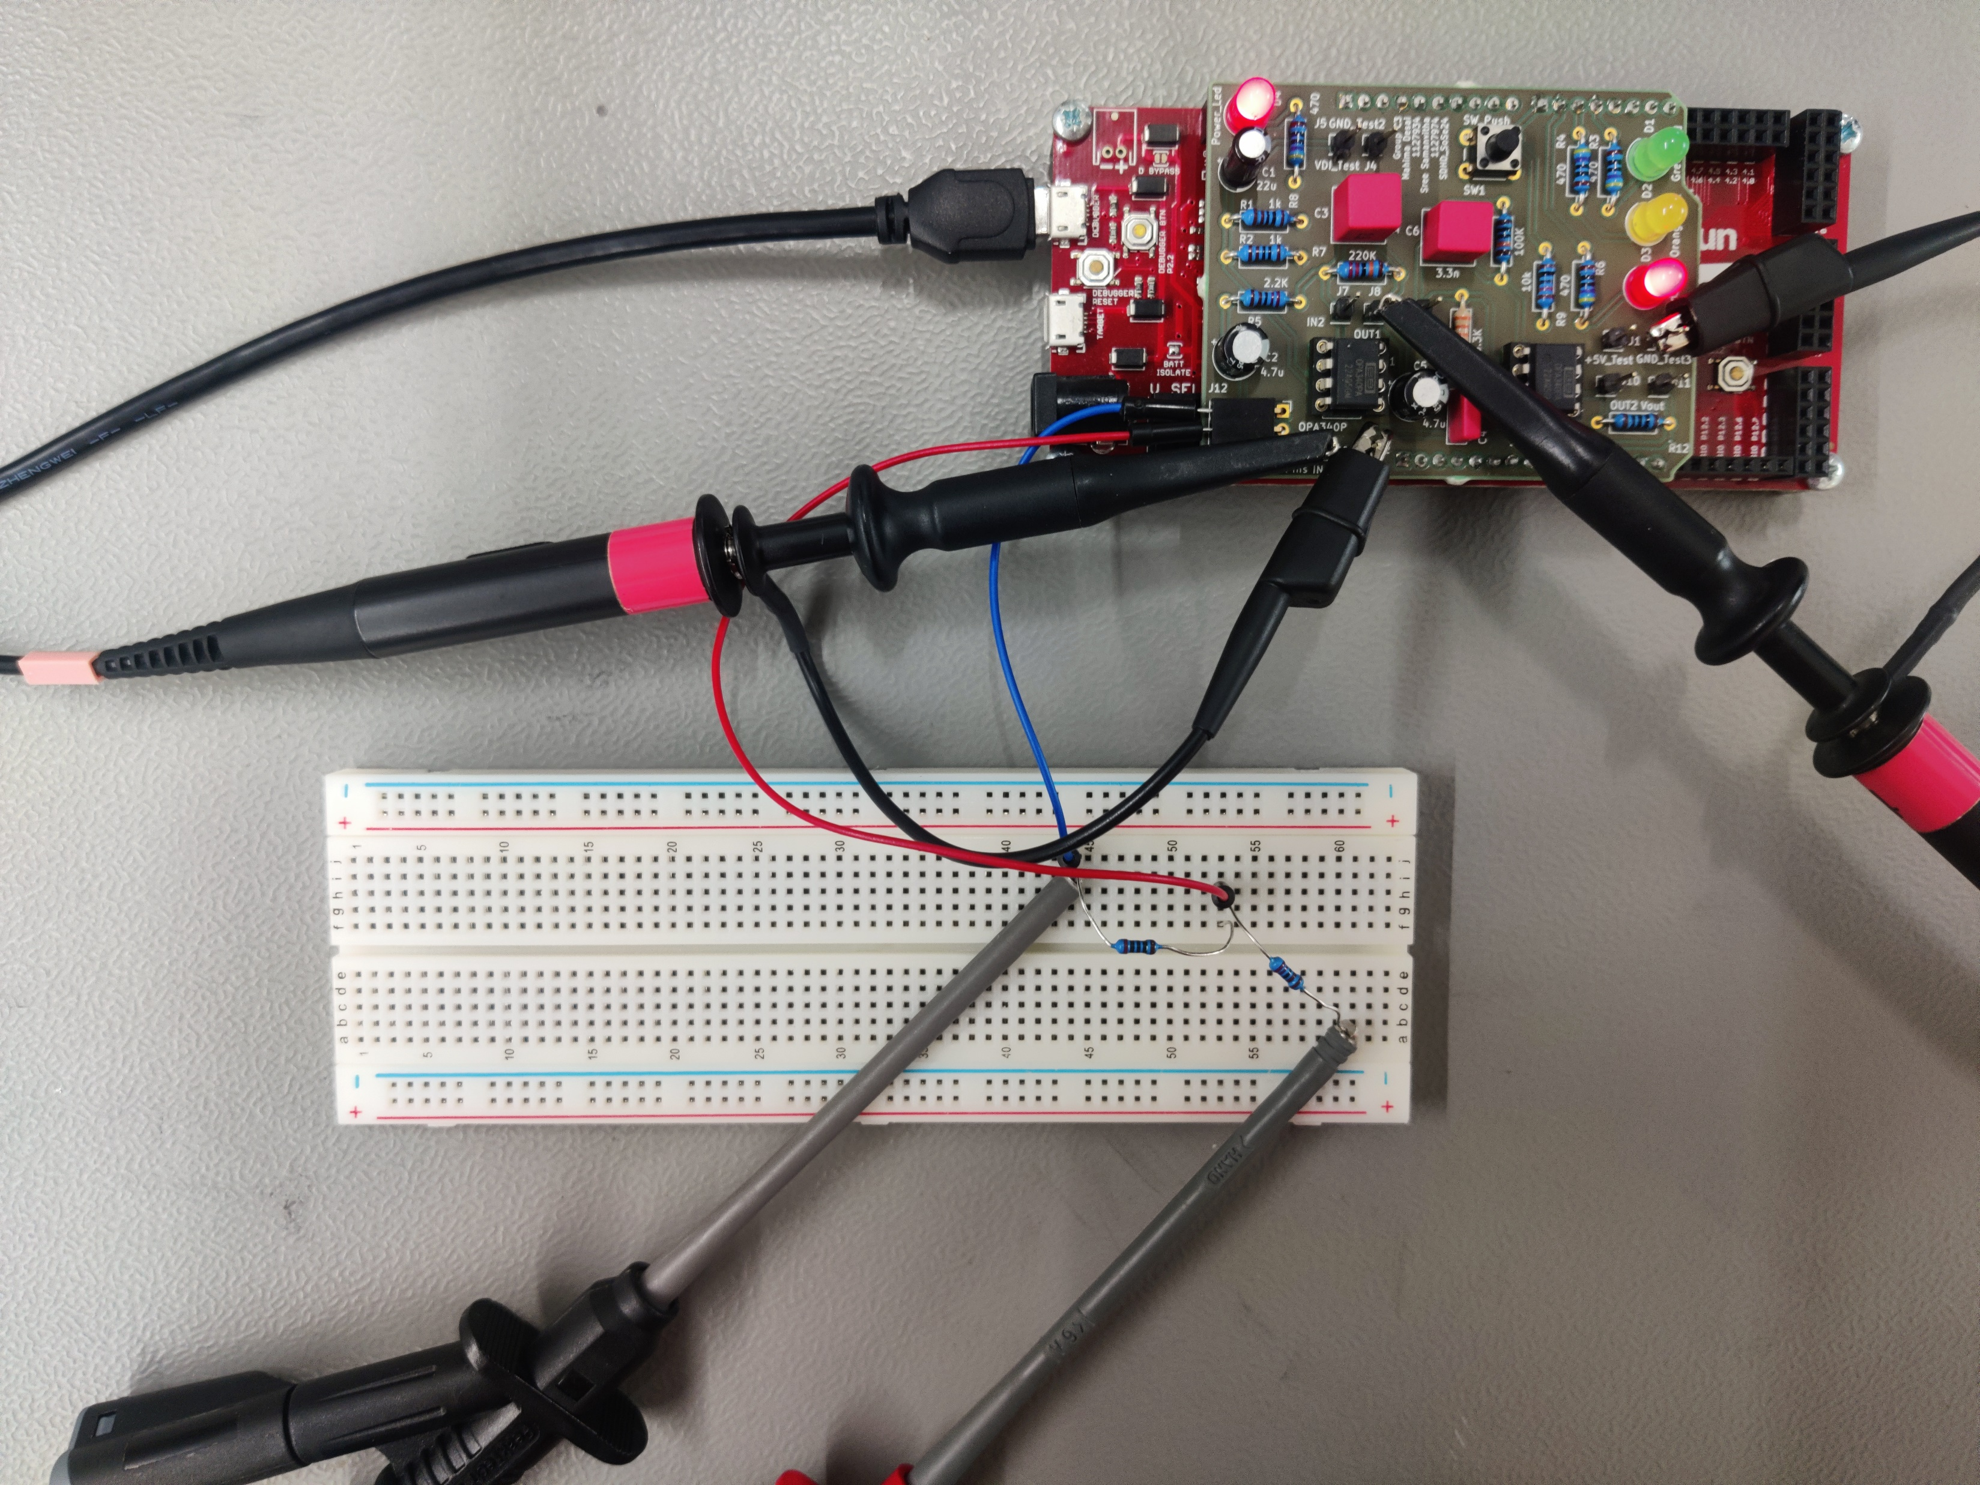
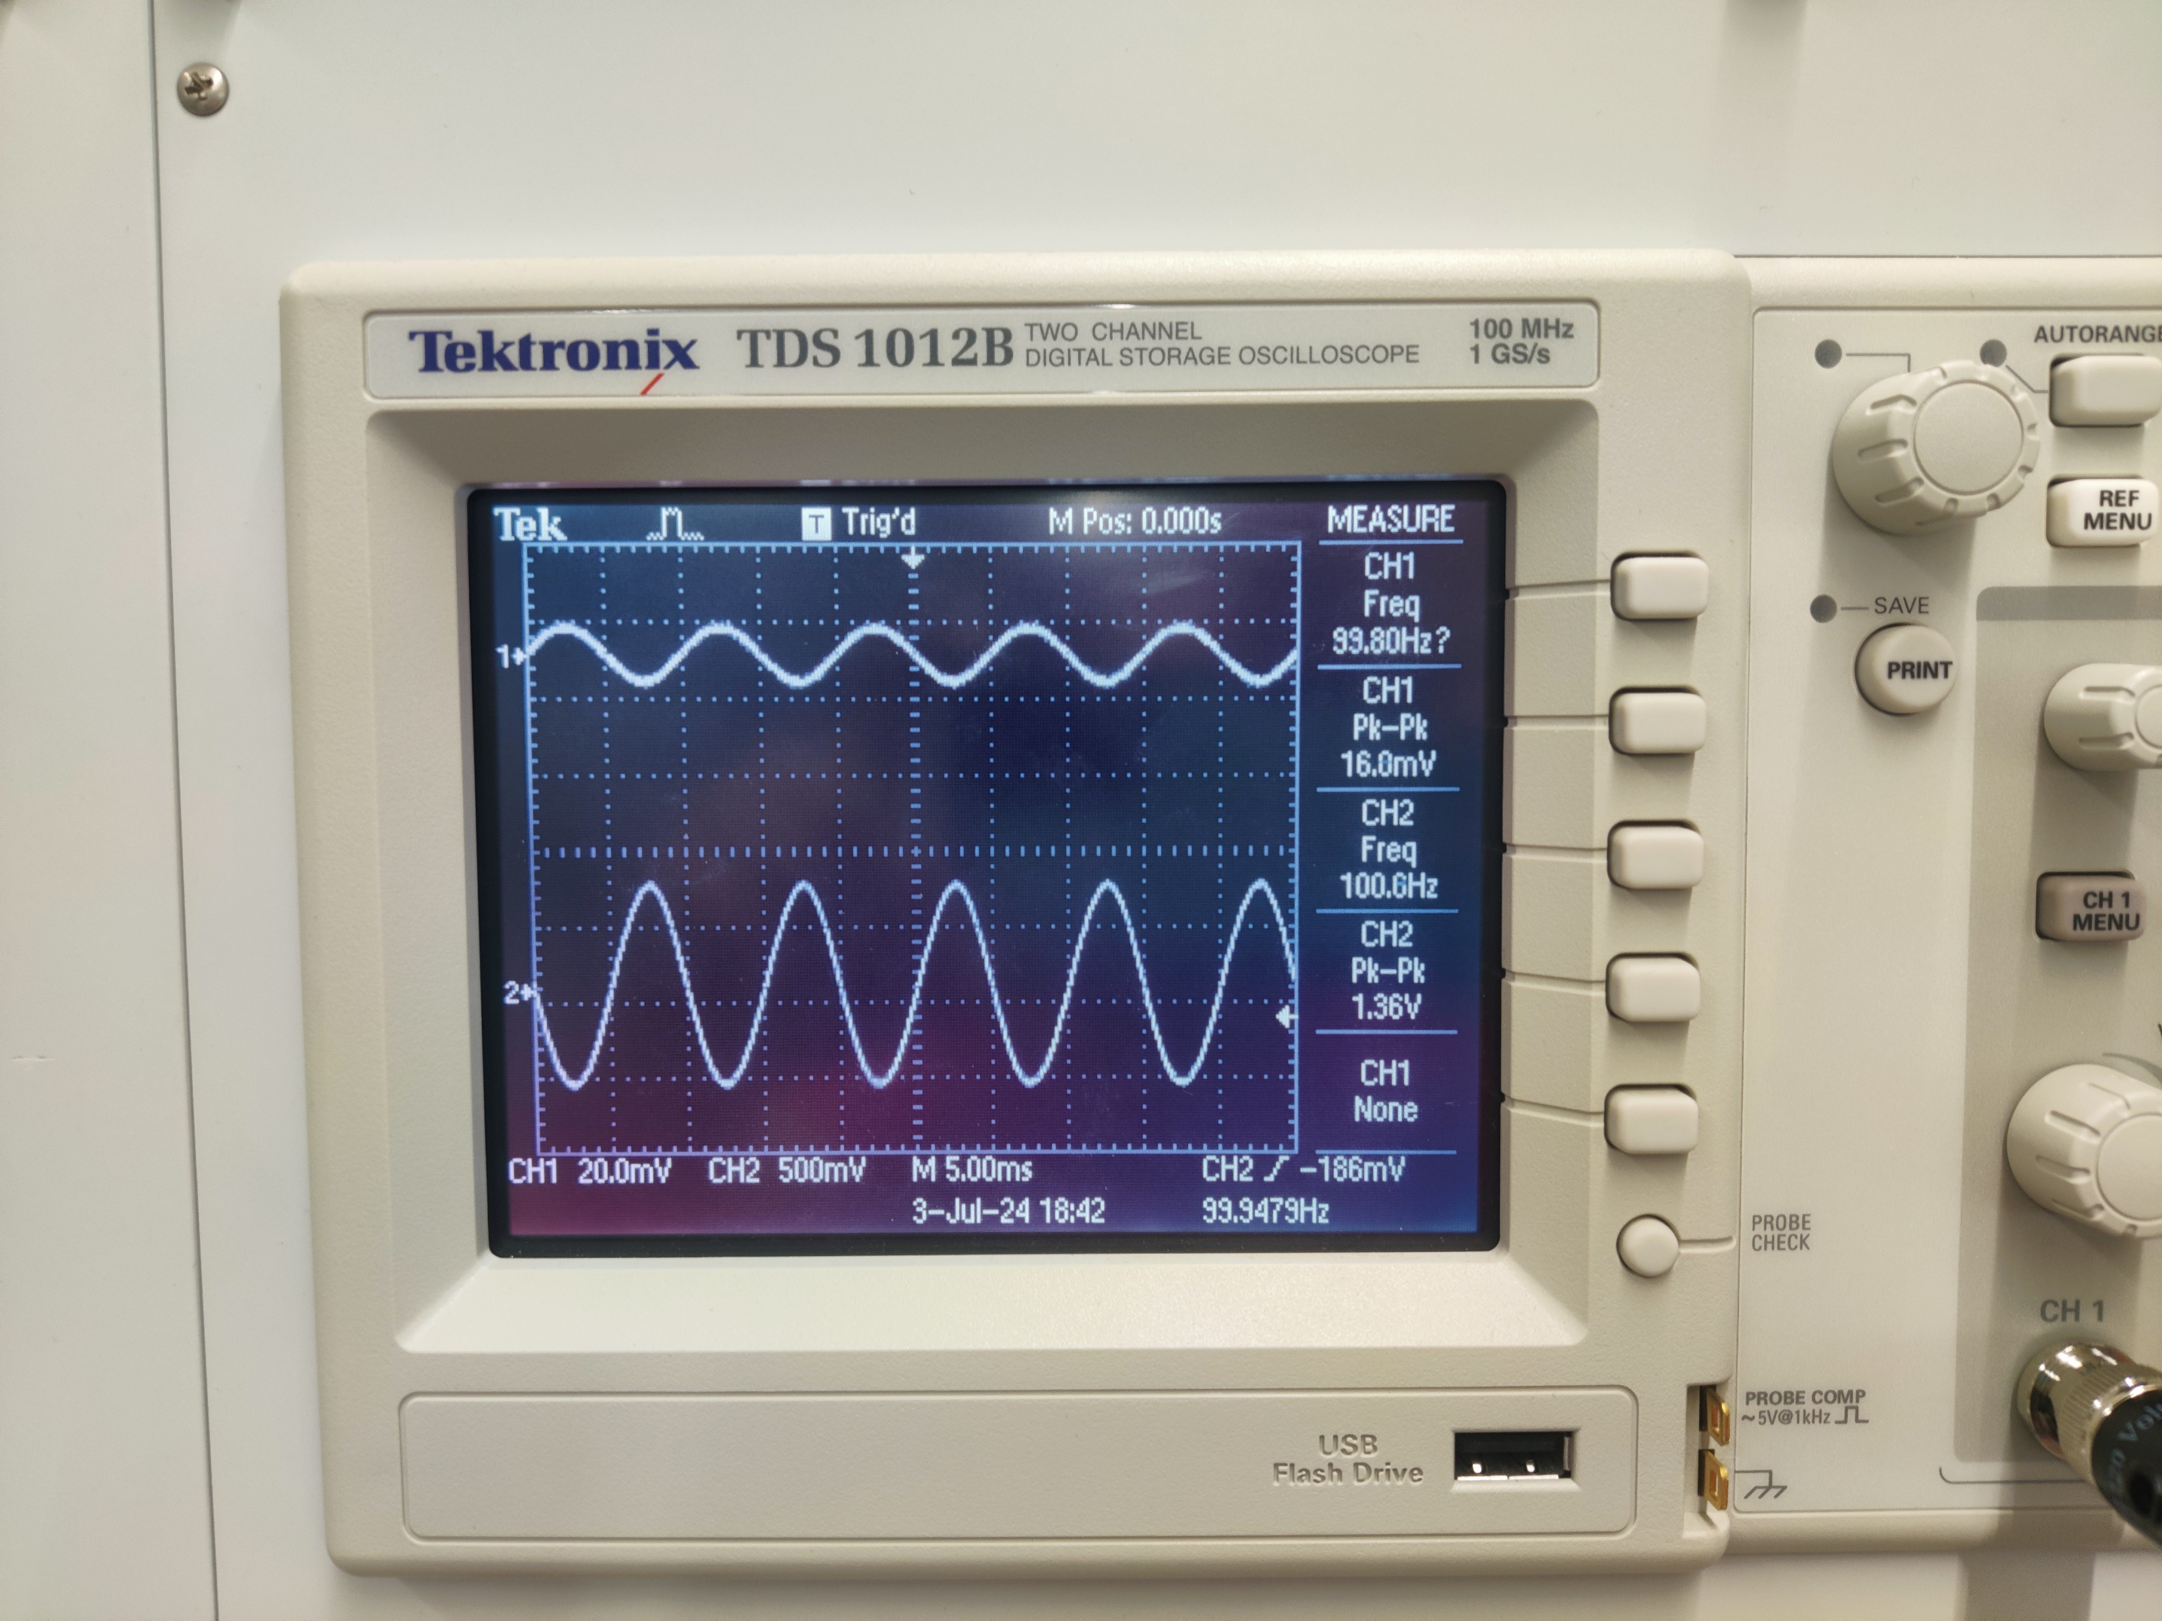
Test Setup for 1st Stage

Slide 16
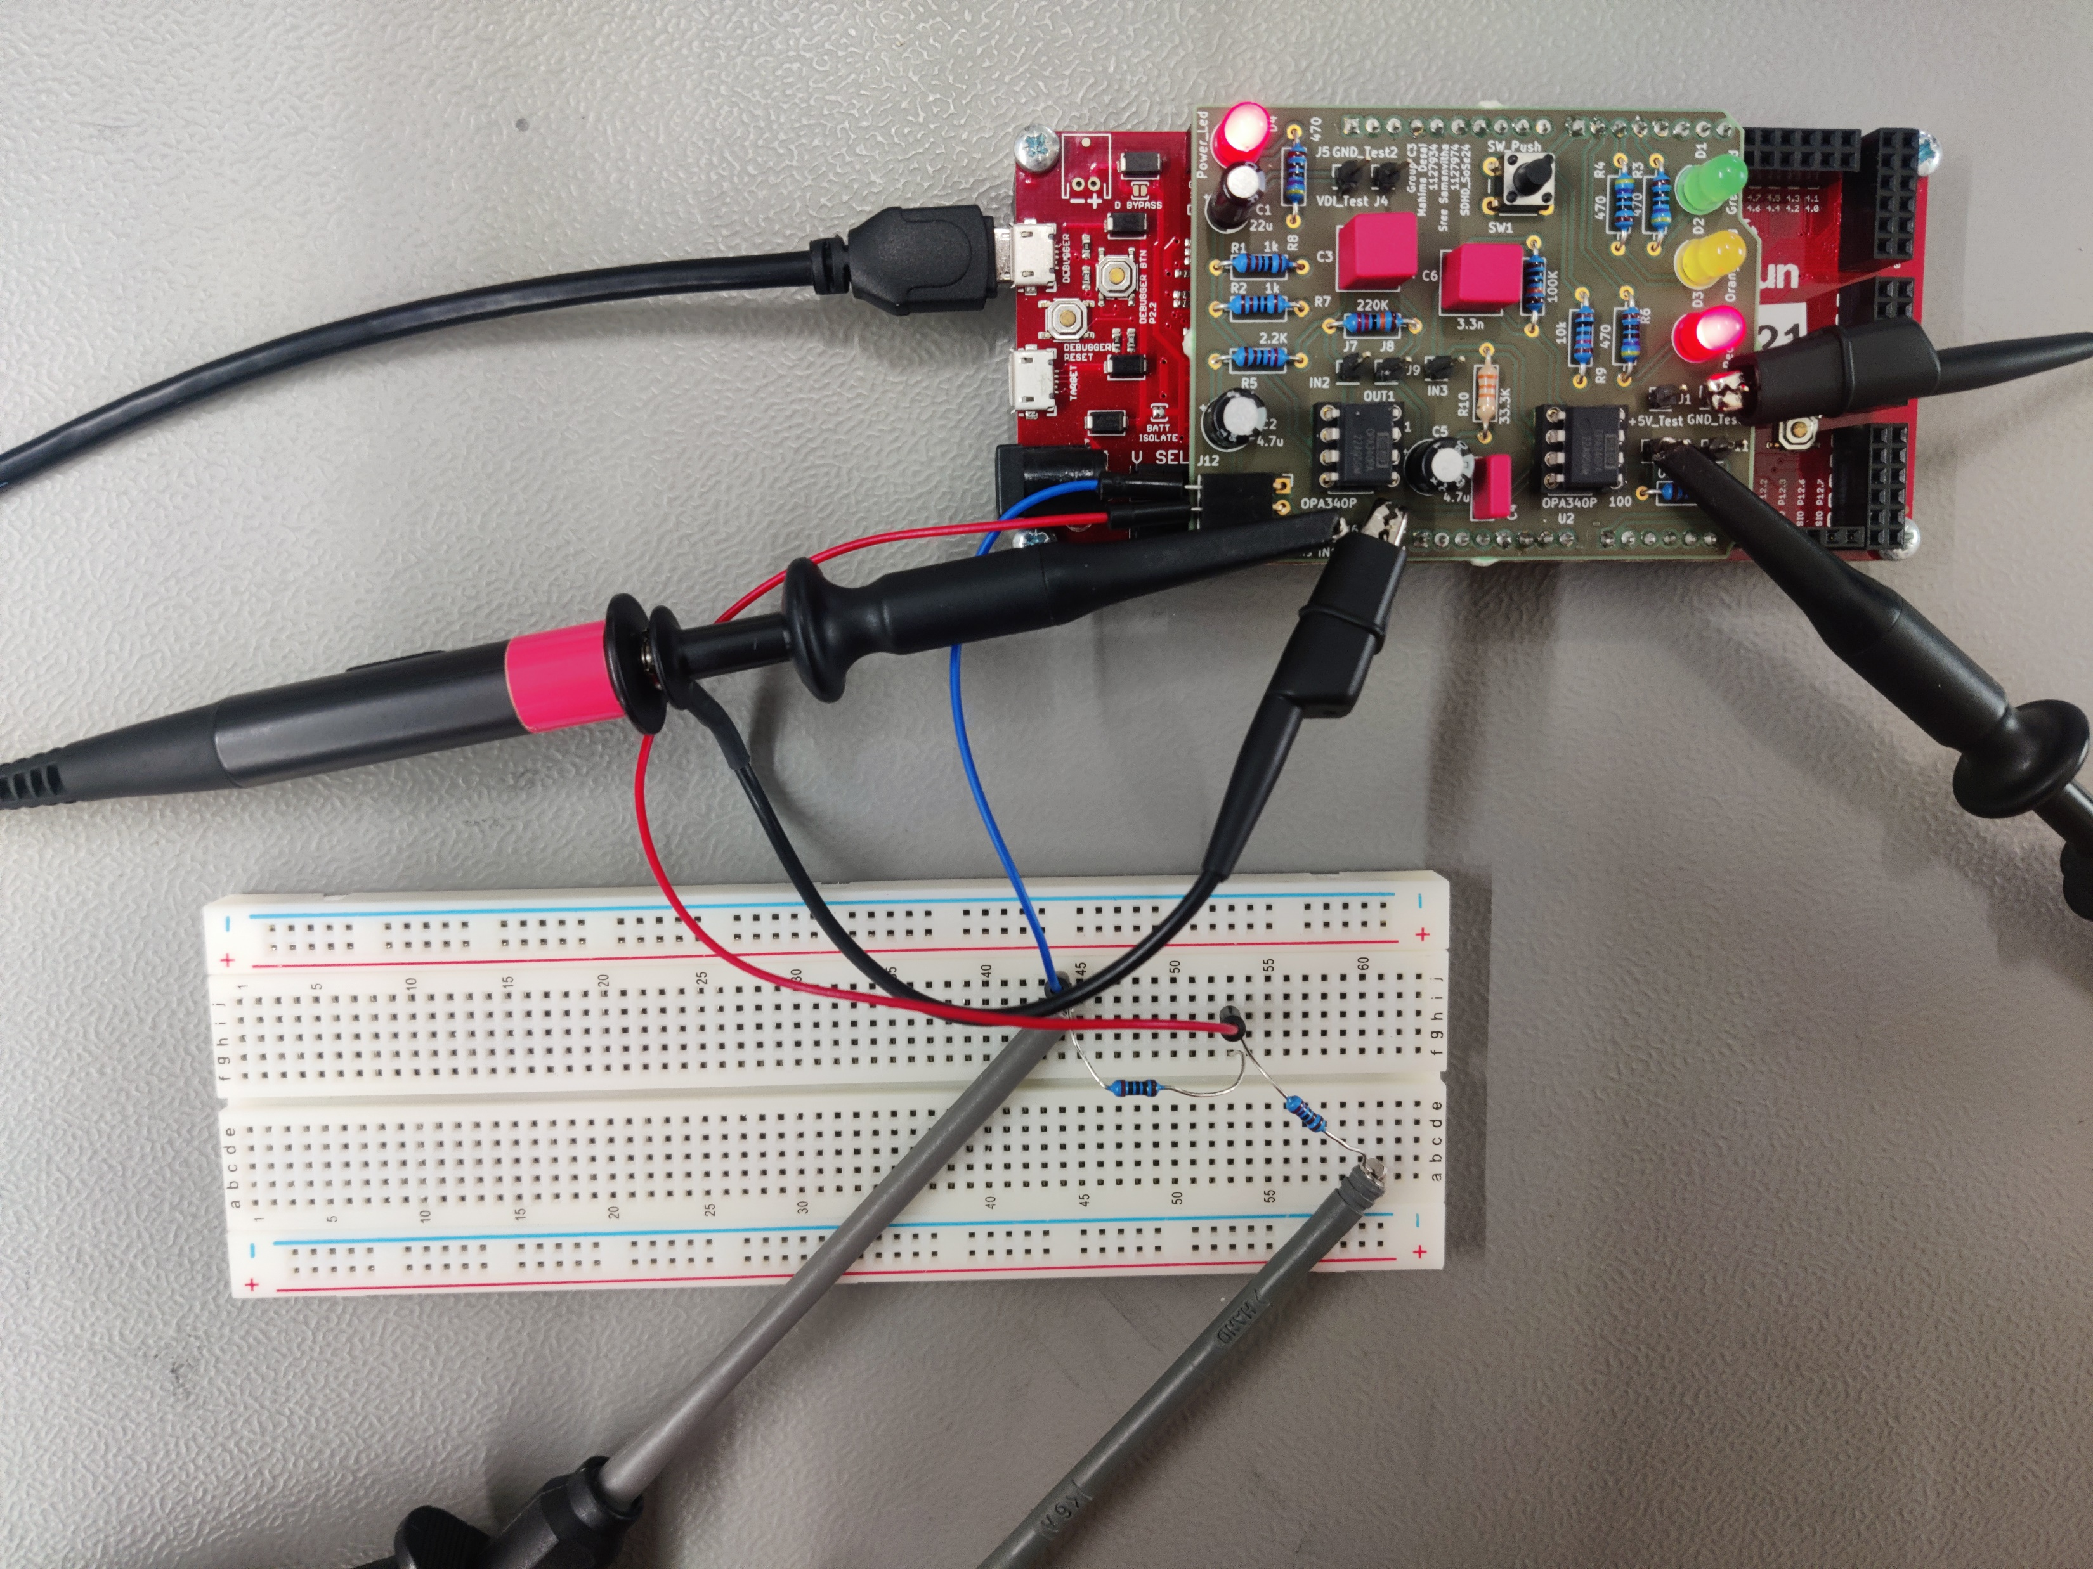
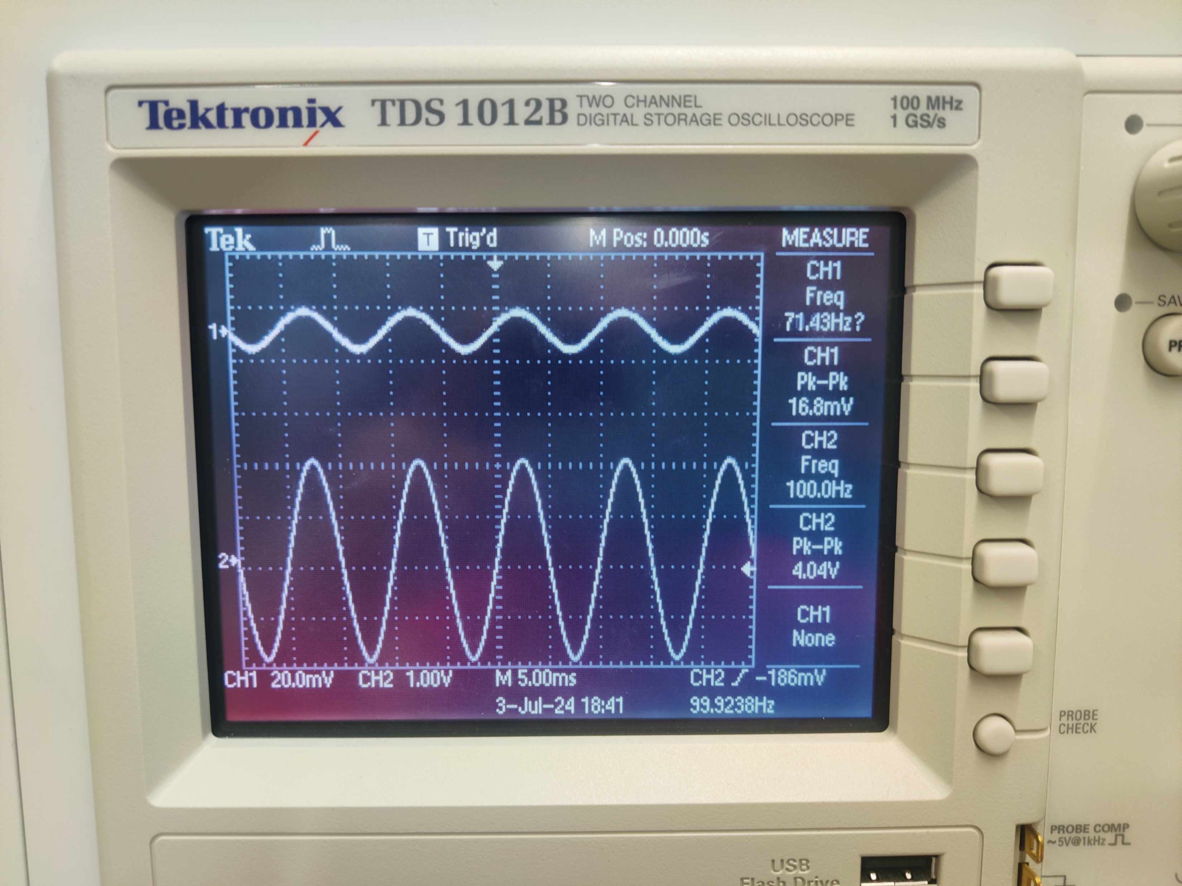
Test Setup for 2nd Stage

Slide 17
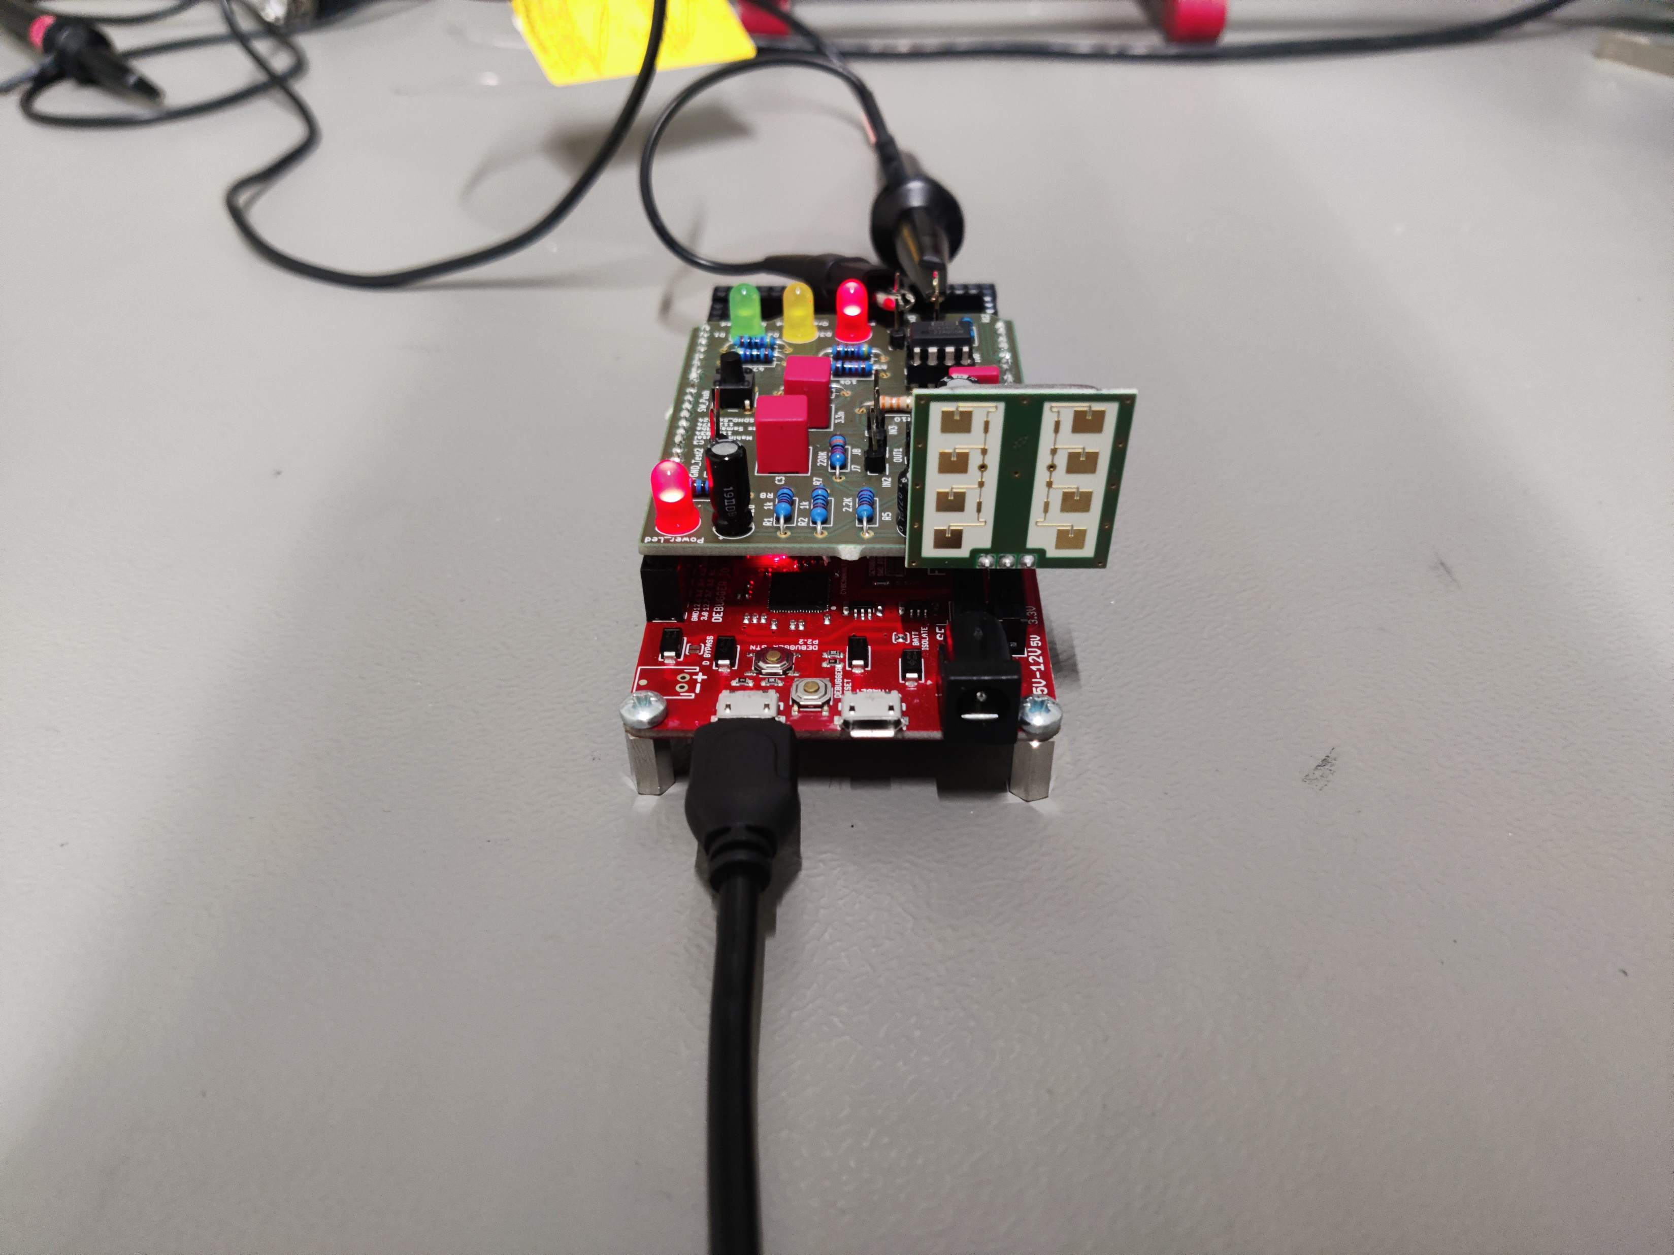
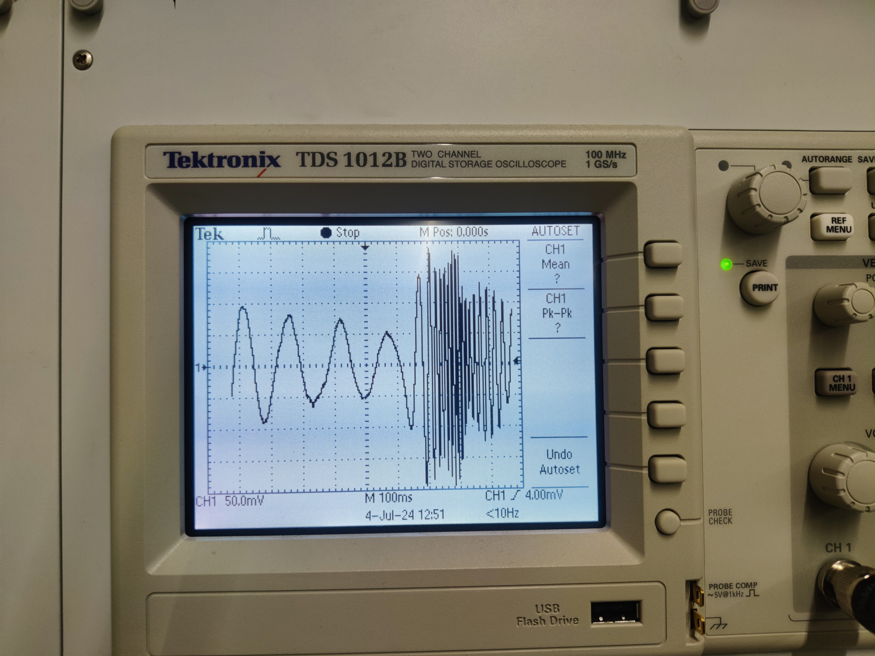
Test Setup for Radar

Slide 18
Gain and Corner Frequencies
Gain verification:
The resistor combination used was 200 ohm and 2.2K ohm.
Output at Voltage divider expected = 16mV
Measured = 14mV
After the first stage :
Calculated value = 1.6V
Measured amplitude = 1.4V
After second stage:
Calculated value = 4.8V
Measured amplitude = 4.02V
Expected gain = 300
Measured gain = 287.5
Corner frequency verification:
Max amplitude measured = 4V
Applying 3db drop = 2.82V
Measured corner frequencies
fL = 18.5 Hz
fH = 329 Hz

Slide 19
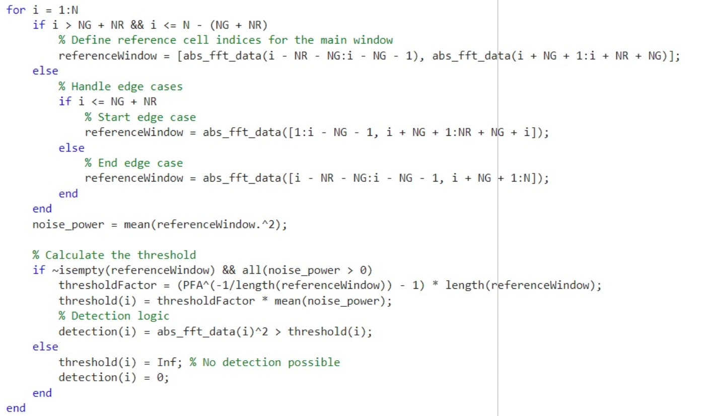
CFAR

Slide 20
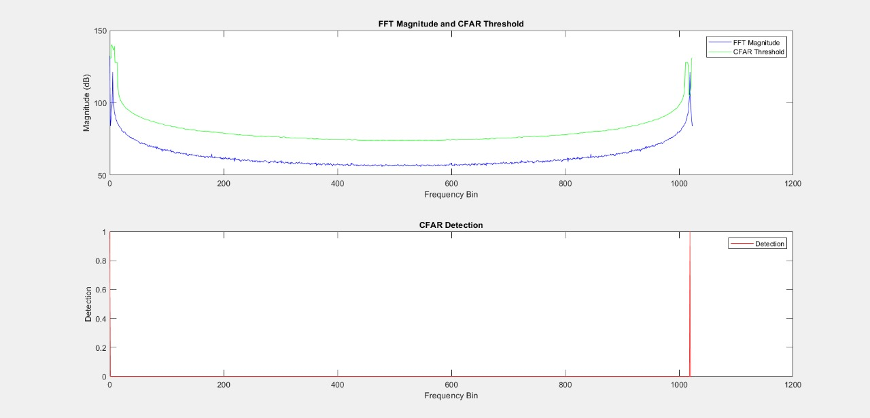
CFAR Results

Slide 21
Thank you

